Slide 1

PHP
SECURITY & FORM VALIDATION

Slide 2


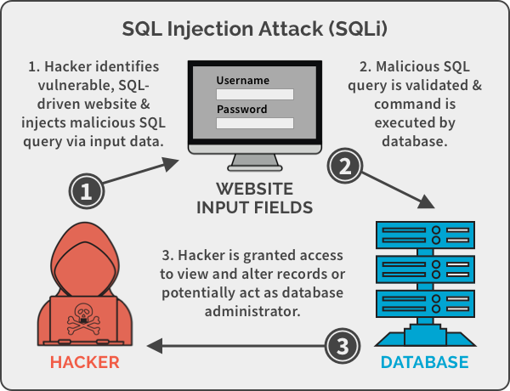
EXPLAIN
What is SQL injection ?
10 MIN
CLASS
SQL injection is a way to manipulate a SQL query to access information from a database

Slide 3

What is SQL injection ?
If code is not well written, you can easily change the SQL condition directly from the POST or GET parameters !!!
$user_id = "2 OR True";
$statement = $db->query("SELECT username FROM users WHERE id=$userid;");
$users = $statement->fetchAll();
SELECT username FROM users WHERE id=2 OR True;
We will display ALL users !
Always true !

Slide 4

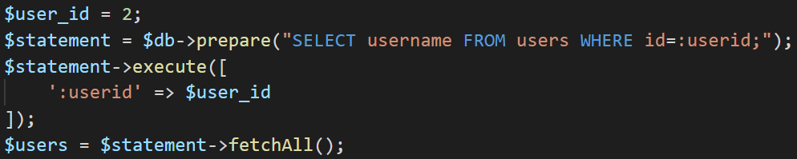
To fix it : prepare + bind + execute
1
2
Instead of executing query directly, we prepare, and then we execute
1
When using parameters, write “:”
2
Use an associative array to “bind” the values

